Slide 1
GRADE 7 ACCELERATED · UNIT 3 · LESSON 1
Product Laws of Exponents
MA.7.NSO.1.1
I can use the product of powers, power of a product, power of a power and identity laws to rewrite and evaluate a numerical expression.
Last unit you took roots apart.
Today you put powers together — and the base has to match.
Grade 7 Accelerated · Unit 3 · Lesson 1 — Product Laws of Exponents
1

Slide 2
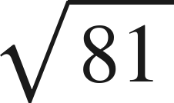
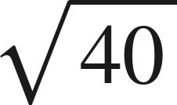

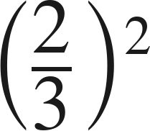
Warm-Up
On your own. Four minutes. No notes.
1.
2. Between which two whole numbers is
?
3. Solve
4. Evaluate
Grade 7 Accelerated · Unit 3 · Lesson 1 — Product Laws of Exponents
2

Slide 3

Warm-Up
Answers.
1.
9
2. Between which two whole numbers is
?
6 and 7
3. Solve
x = 6
4. Evaluate
Grade 7 Accelerated · Unit 3 · Lesson 1 — Product Laws of Exponents
3

Slide 4
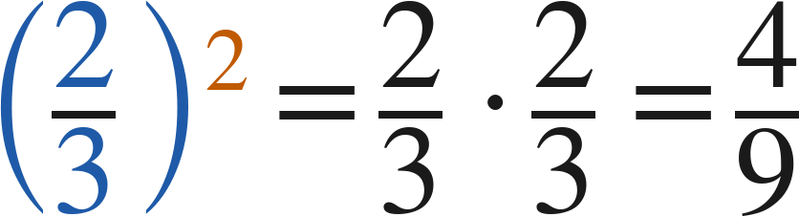
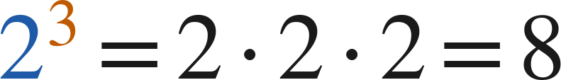
Notes
Copy the three words.
I. A power is a shorthand for repeated multiplication
A.
base — the number used as a factor
B.
exponent — how many times the base is a factor
C.
power — the whole thing, base and exponent together
Grade 7 Accelerated · Unit 3 · Lesson 1 — Product Laws of Exponents
4

Slide 5
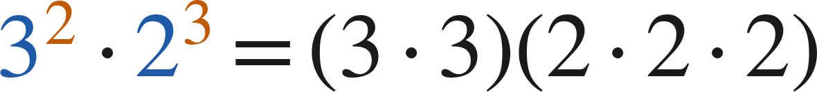

Notes
Where the rule comes from.
II. Product of powers — same base, add the exponents
— different bases, no shortcut
Product of powers:
Check with values:
Grade 7 Accelerated · Unit 3 · Lesson 1 — Product Laws of Exponents
5

Slide 6

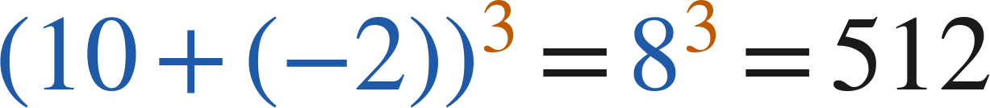

Notes
III. Power of a product — the exponent goes to every factor
Power of a product:
Works for a product only, never for a sum:
but
Grade 7 Accelerated · Unit 3 · Lesson 1 — Product Laws of Exponents
6

Slide 7

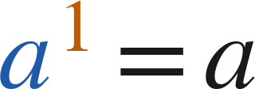
Notes
IV. Power of a power, and the exponent 1
Power of a power | Repeated multiplication | Single power
(4²)³ | 4² · 4² · 4² | 4⁶
(10⁴)⁴ | 10⁴ · 10⁴ · 10⁴ · 10⁴ | 10¹⁶
(3¹)⁵ | 3 · 3 · 3 · 3 · 3 | 3⁵
Power of a power:
Identity:
Grade 7 Accelerated · Unit 3 · Lesson 1 — Product Laws of Exponents
7

Slide 8

Example 1
Two ways to the same value.
Which law? Then find the value.
Grade 7 Accelerated · Unit 3 · Lesson 1 — Product Laws of Exponents
8

Slide 9



Example 1
Worked both ways.
product of powers: same base, add
evaluate the single power
check: evaluate each, then multiply
Answer: 243
Grade 7 Accelerated · Unit 3 · Lesson 1 — Product Laws of Exponents
9

Slide 10

Your Turn
Same steps, your numbers. Boards up when done.
Grade 7 Accelerated · Unit 3 · Lesson 1 — Product Laws of Exponents
10

Slide 11

Your Turn
Answer.
same base, add: 2⁷
Answer: 2⁷ = 128
Grade 7 Accelerated · Unit 3 · Lesson 1 — Product Laws of Exponents
11

Slide 12
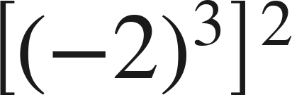
Example 2
A negative base and a power of a power.
Which law? Then find the value.
Grade 7 Accelerated · Unit 3 · Lesson 1 — Product Laws of Exponents
12

Slide 13
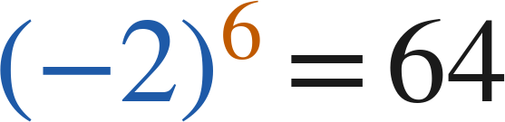

Example 2
Worked.
power of a power: multiply
six negative factors — positive
check: (−2)³ = −8, then square
Answer: 64
Grade 7 Accelerated · Unit 3 · Lesson 1 — Product Laws of Exponents
13

Slide 14
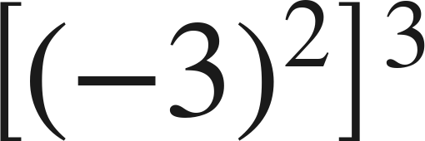
Your Turn
Same steps, your numbers. Boards up when done.
Grade 7 Accelerated · Unit 3 · Lesson 1 — Product Laws of Exponents
14

Slide 15

Your Turn
Answer.
multiply the exponents: (−3)⁶
Answer: (−3)⁶ = 729
Grade 7 Accelerated · Unit 3 · Lesson 1 — Product Laws of Exponents
15

Slide 16

Whiteboards · Question 1 of 9
Boards up on three.
Answer it.
Write it as one power.
Grade 7 Accelerated · Unit 3 · Lesson 1 — Product Laws of Exponents
16

Slide 17


Whiteboards · Question 1 of 9
Answer.
same base, so add the exponents
Answer:
Grade 7 Accelerated · Unit 3 · Lesson 1 — Product Laws of Exponents
17

Slide 18



Whiteboards · Question 2 of 9
Boards up on three.
A photo is enlarged
times, then
times more.
In all it is
times bigger. The photo is 9 cm wide.
Write
as one power. Then find its value.
Answer it.
Grade 7 Accelerated · Unit 3 · Lesson 1 — Product Laws of Exponents
18

Slide 19



Whiteboards · Question 2 of 9
Answer.
A photo is enlarged
times, then
times more.
In all it is
times bigger. The photo is 9 cm wide.
Write
as one power. Then find its value.
2⁴ · 2² = 2⁶
Answer: 2⁶ = 64
Grade 7 Accelerated · Unit 3 · Lesson 1 — Product Laws of Exponents
19

Slide 20
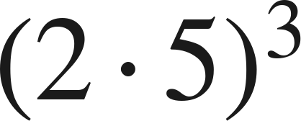
Whiteboards · Question 3 of 9
Boards up on three.
Answer it.
Find the value.
Grade 7 Accelerated · Unit 3 · Lesson 1 — Product Laws of Exponents
20

Slide 21

Whiteboards · Question 3 of 9
Answer.
2³ · 5³ = 8 · 125, or 10³
Answer: 1000
Grade 7 Accelerated · Unit 3 · Lesson 1 — Product Laws of Exponents
21

Slide 22
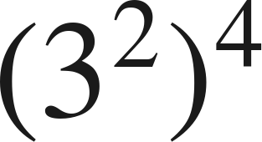
Whiteboards · Question 4 of 9
Boards up on three.
Answer it.
Write it as one power.
Grade 7 Accelerated · Unit 3 · Lesson 1 — Product Laws of Exponents
22

Slide 23
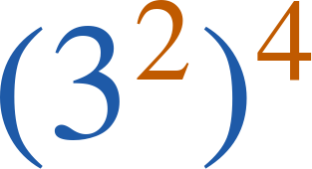

Whiteboards · Question 4 of 9
Answer.
four copies of 3², so eight 3s
Answer:
Grade 7 Accelerated · Unit 3 · Lesson 1 — Product Laws of Exponents
23

Slide 24

Whiteboards · Question 5 of 9
Boards up on three.
Which expression is equivalent?
A. 16⁵
B. 8⁵
C. 4⁶
D. 4⁵
Answer it.
Grade 7 Accelerated · Unit 3 · Lesson 1 — Product Laws of Exponents
24

Slide 25

Whiteboards · Question 5 of 9
Answer.
Which expression is equivalent?
A. 16⁵
B. 8⁵
C. 4⁶
D. 4⁵
Answer: D — 4⁵
Grade 7 Accelerated · Unit 3 · Lesson 1 — Product Laws of Exponents
25

Slide 26
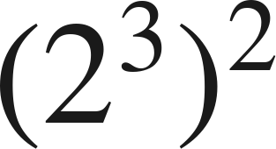
Whiteboards · Question 6 of 9
Boards up on three.
Which expression is equivalent?
A. 2⁵
B. 4⁶
C. 2⁶
D. 2⁹
Answer it.
Grade 7 Accelerated · Unit 3 · Lesson 1 — Product Laws of Exponents
26

Slide 27
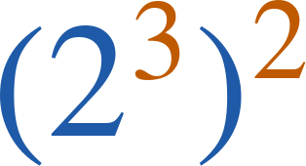
Whiteboards · Question 6 of 9
Answer.
Which expression is equivalent?
A. 2⁵
B. 4⁶
C. 2⁶
D. 2⁹
Answer: C — 2⁶
Grade 7 Accelerated · Unit 3 · Lesson 1 — Product Laws of Exponents
27

Slide 28
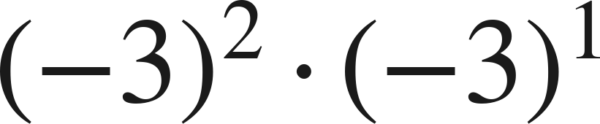
Whiteboards · Question 7 of 9
Boards up on three.
Answer it.
Find the value.
Grade 7 Accelerated · Unit 3 · Lesson 1 — Product Laws of Exponents
28

Slide 29
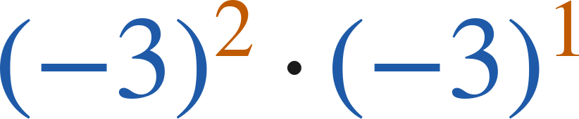
Whiteboards · Question 7 of 9
Answer.
(−3)³ — three negative factors
Answer: −27
Grade 7 Accelerated · Unit 3 · Lesson 1 — Product Laws of Exponents
29

Slide 30
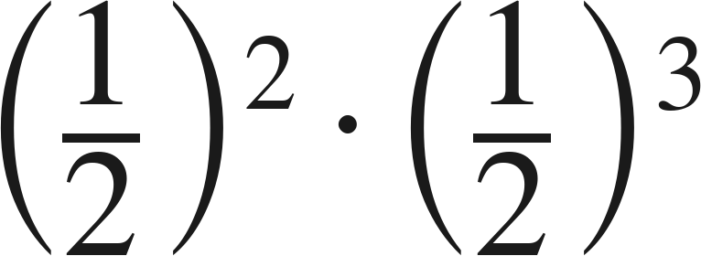
Whiteboards · Question 8 of 9
Boards up on three.
Answer it.
Find the value.
Grade 7 Accelerated · Unit 3 · Lesson 1 — Product Laws of Exponents
30

Slide 31
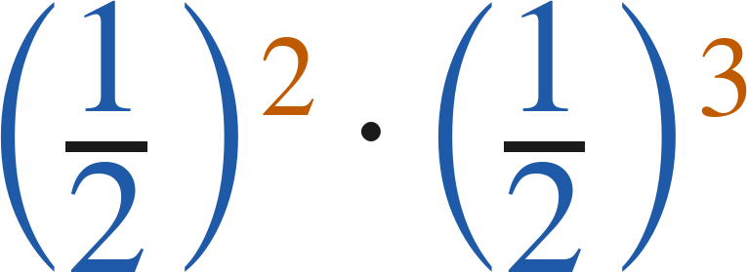

Whiteboards · Question 8 of 9
Answer.
(½)⁵
Answer:
Grade 7 Accelerated · Unit 3 · Lesson 1 — Product Laws of Exponents
31

Slide 32
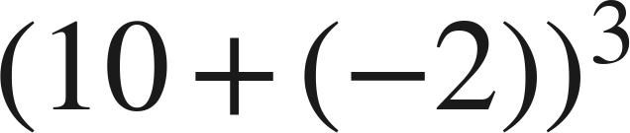
Whiteboards · Question 9 of 9
Take your time. Boards up when you have written it.
Aiyanna says she can use the power of a product law
to evaluate
. Is she right?
Write your answer in sentences.
Say what the law needs, and show the value.
Grade 7 Accelerated · Unit 3 · Lesson 1 — Product Laws of Exponents
32

Slide 33

Whiteboards · Question 9 of 9
Answer.
Aiyanna says she can use the power of a product law
to evaluate
. Is she right?
the parentheses hold a SUM, not a product
Answer: No — (10 + (−2))³ = 8³ = 512
Grade 7 Accelerated · Unit 3 · Lesson 1 — Product Laws of Exponents
33

Slide 34
Independent Set
Six questions. On your own, in silence.
1.
Six questions. Work down the page.
2.
Show the step that does the work, not just the answer.
3.
Silence until the six minutes are up.
Grade 7 Accelerated · Unit 3 · Lesson 1 — Product Laws of Exponents
34

Slide 35
IXL
Last five minutes.
1.
Open IXL and start today's skills.
2.
Work on paper where the question needs work. The answer box does not show it.
3.
Every skill listed is required, to a SmartScore of 67. Due at the start of the next class.
Today's skills — all required
Evaluate powers — SZQ
Multiplication with exponents — 5SK
Power rule — 8DA
Understanding exponents — BFA
Grade 7 Accelerated · Unit 3 · Lesson 1 — Product Laws of Exponents
35

